Slide 1
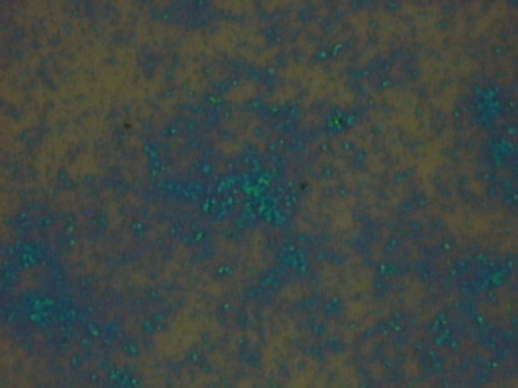
40h(Mad, 3000rpm, unfiltered, 120deg substrate, 5 min soak in water)

Slide 2
